Slide 1
Azure in one line
Gabriel Nepomuceno

Slide 2


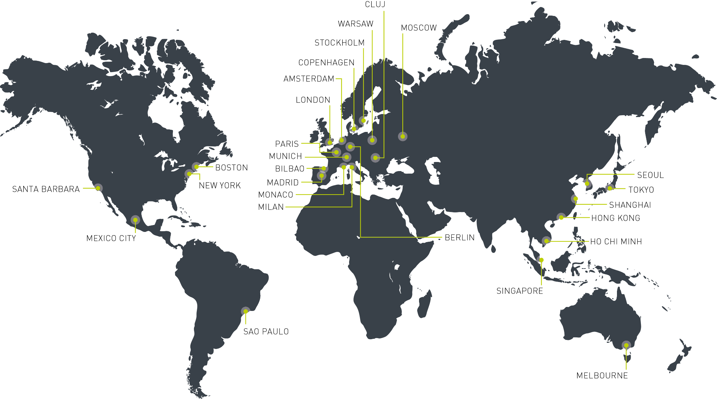





@veinteractive @Ve_Recruitment
Ve Interactive is a full data-driven solutions provider, helping businesses broaden their sites functionalities through our flagship suite of award winning software products and services
Winner of Digital Company of The Year 2013 in the National Business Awards
Named ‘Marketing Solutions Company of the Year’ in The Drum Marketing Awards 2012
3,000+ clients, 250 employees
Flagship software portfolio to maximise e-commerce efficiency for online retailers

Slide 3
Who?
Gabriel Nepomuceno
@gbico
Github.com/nepomuceno
http://nepomuceno.ninja

Slide 4
We all love windows

Slide 5
C:\a\b\c\d\e\f\g\

Slide 6
2000 again

Slide 7
2000 again

Slide 8
We need competition

Slide 9
The movement to the cloud

Slide 10
Automate EVERYTHING

Slide 11
Using terraform with Azure
Notes:
I didn’t knew anything about go. So this was the first problem that I had. Using terraform with Azure is simple painful for some reasons.

Slide 12
Pain!!!!
Notes:
I didn’t knew anything about go. So this was the first problem that I had. Using terraform with Azure is simple painful for some reasons.

Slide 13
Azure templates for the rescue.
{
“hello”: {
“Azure”:“JSON”
}
}

Slide 14
Open source documentation
https://github.com/Azure/azure-content
Incomplete

Slide 15
Best source of documentation
https://github.com/Azure/azure-quickstart-templates

Slide 16
New-AzureResourceGroup
The start of every new deployment

Slide 17
New-AzureRMResourceGroupDeployment
I just love how small are the commands in Powershell

Slide 18
The Parameters
Name (don’t care about this)
ResourceGroupName
TemplateFile
TemplateParameterFiles
Gallery things and object things (normally don’t used)
Mode

Slide 19
Demo
No, I’m not lying this things exist! ☺
Notes:
Base creation of resource group. Only with ip and availability set for the sake of time.

Slide 20
Test-AzureResourceGroupDeployment
Because everyone do tests ;)

Slide 21
The Parameters
ResourceGroupName
TemplateFile
TemplateParameterFiles
Mode

Slide 22
Demo
So tests can fail!
Notes:
Base creation of resource group. Only with ip and availability set for the sake of time.

Slide 23
The files

Slide 24
The resource template

Slide 25
Strip in parts

Slide 26
Parameters

Slide 27
Variables
X = ?

Slide 28
Resources

Slide 29
The parameter file
Because is boring to keep typing all the parameters

Slide 30
Parameters

Slide 31
Demo
Something Complex!

Slide 32
Ok Too complex!

Slide 33
Maintainability!

Slide 34
Linked Templates!

Slide 35
Demo
Linked resources!

Slide 36
Topics for other talks
Gotchas
Provisioning
Testing templates
Hidden Types

Slide 37
@veinteractive @Ve_Recruitment
Ve Interactive is a full data-driven solutions provider, helping businesses broaden their sites functionalities through our flagship suite of award winning software products and services
Winner of Digital Company of The Year 2013 in the National Business Awards
Named ‘Marketing Solutions Company of the Year’ in The Drum Marketing Awards 2012
3,000+ clients, 250 employees
Flagship software portfolio to maximise e-commerce efficiency for online retailers

Slide 38
Questions?
Here or later ;)

Slide 39
@veinteractive @Ve_Recruitment
Ve Interactive is a full data-driven solutions provider, helping businesses broaden their sites functionalities through our flagship suite of award winning software products and services
Winner of Digital Company of The Year 2013 in the National Business Awards
Named ‘Marketing Solutions Company of the Year’ in The Drum Marketing Awards 2012
3,000+ clients, 250 employees
Flagship software portfolio to maximise e-commerce efficiency for online retailers

